Slide 1


t
PIZZAHUT
SQL PROJECT
Designed and implemented a relational database system for managing Pizza Hut orders efficiently. The database stores order details, including date, time and itemized order breakdowns, ensuring seamless data retrieval and management.

Slide 2

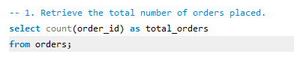
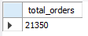
Retrieve the total number of orders placed.
Solution:

Slide 3

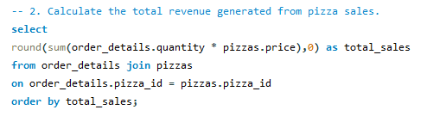
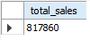
Calculate the total revenue generated from pizza sales.
Solution:

Slide 4

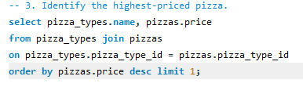
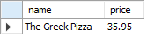
Identify the highest-priced pizza.
Solution:

Slide 5

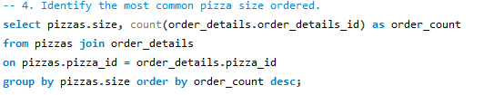
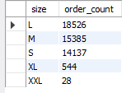
1
Identify the most common pizza size ordered.
Solution:

Slide 6

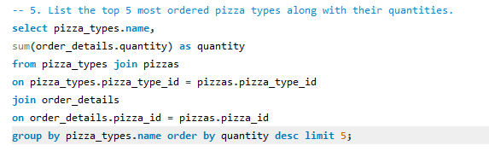
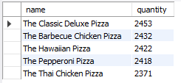
List the top 5 most ordered pizza types along with their quantities.
Solution:

Slide 7

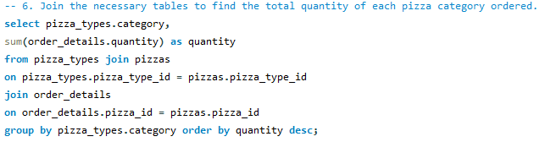
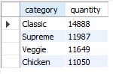
Find the total quantity of each pizza category ordered.
Solution:

Slide 8

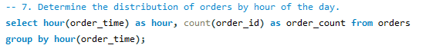
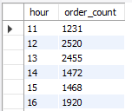
Determine the distribution of orders by hour of the day.
Solution

Slide 9

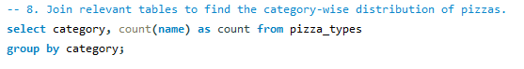
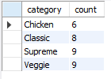
Find the category-wise distribution of pizzas.
Solution:

Slide 10

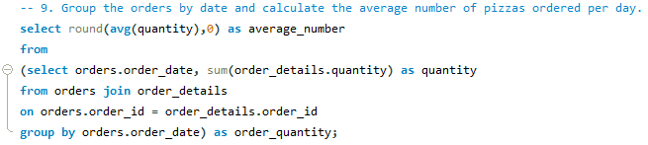
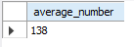
calculate the average number of pizzas ordered per day.
Solution:

Slide 11

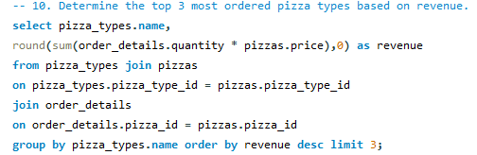
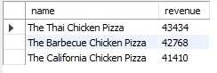
Determine the top 3 most ordered pizza types based on revenue.
Solution:

Slide 12

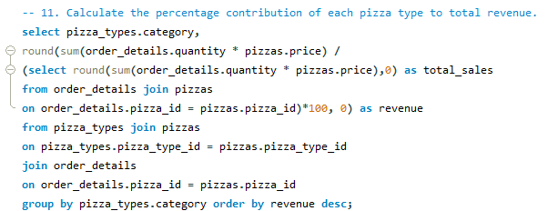
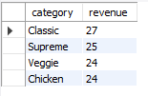
Calculate the percentage contribution of each pizza type to total revenue.
Solution:

Slide 13

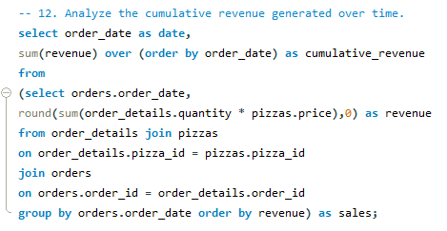
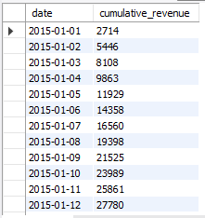
Analyze the cumulative revenue generated over time.
Solution:

Slide 14
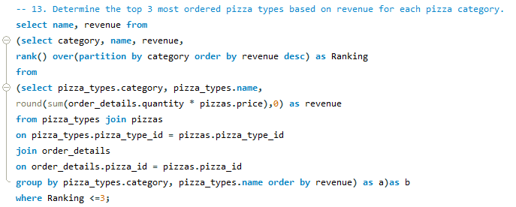
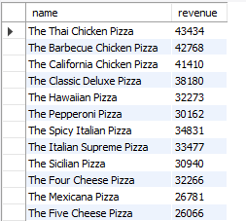
Determine the top 3 most ordered pizza types based on revenue for each pizza category.
Solution:

